Slide 1
Rational design
Cameron Shelley
STV 202

Slide 2
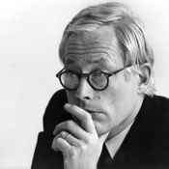
The best solution
Dieter Rams describes design as a professional role
Concerns good professional practice
Entails a social mission
Not all designers are professionals, or work in the same profession
Herbert Simon describes design as problem solving
Design involves solving a problem in the best possible way
Good design is rational
This approach is more general and impersonal than Rams’s
However, it also requires God-like abilities

Slide 3
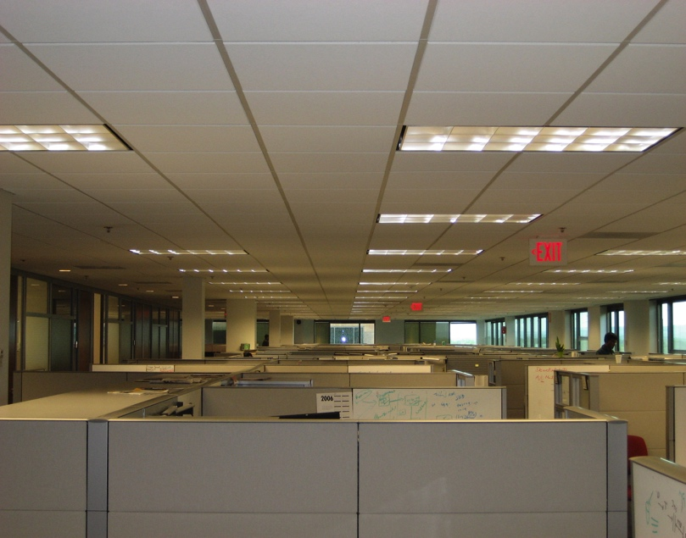
Case study: the open office…
Cubicles were introduced in the 1960s
Provide privacy to “knowledge workers”
Provide adaptability and cost-efficiency to managers
However, cubicles stifle interaction and facilitate loafing

Slide 4
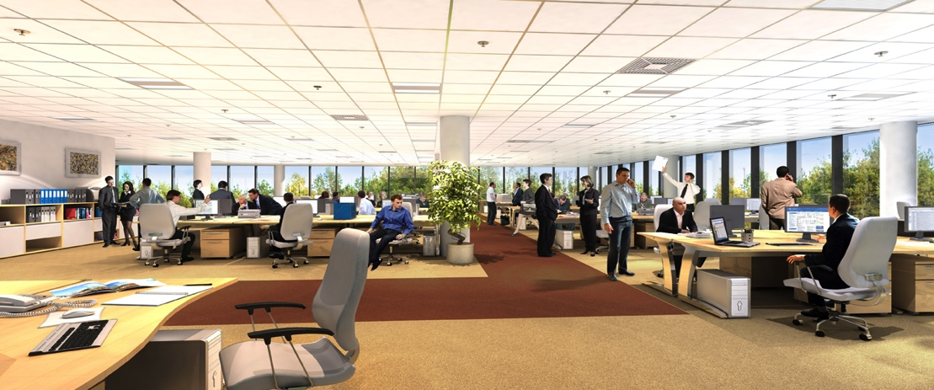
The open office
The open office was introduced in the late 1990s
Provides opportunities to interact among “knowledge workers”
Allows managers and fellow employees to police loafing
However, open office designs can be distracting and stressful
Was the open office design a rational response to the problems of cubicles?

Slide 5
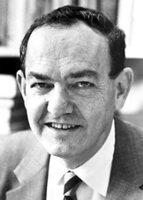
Herbert Simon (1916–2001)
Ph.D. in PoliSci from Chicago (1943)
Moved to CMU (1949)
Studied human decision-making
Staged in organizations
Psychologically plausible models
Computer simulations of human reasoning
Awards included:
APA Award for distinguished contributions to Psychology (1969)
ACM Turing Award for contributions to AI (1975)
Nobel Memorial Prize in Economics (1978)
Herbert Simon

Slide 6
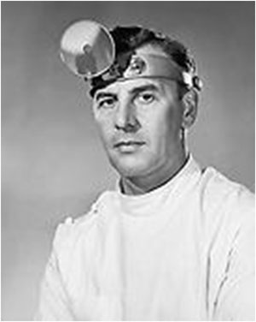
Design problems
Science versus engineering
Science concerns natural systems
Engineering concerns artificial systems
On design:
“Everyone designs who devises courses of action aimed at changing existing situations into preferred ones. … Schools of engineering, as well as schools of architecture, business, education, law, and medicine, are all centrally concerned with the process of design.”
How is a doctor a designer, on this view? A novelist?

Slide 7
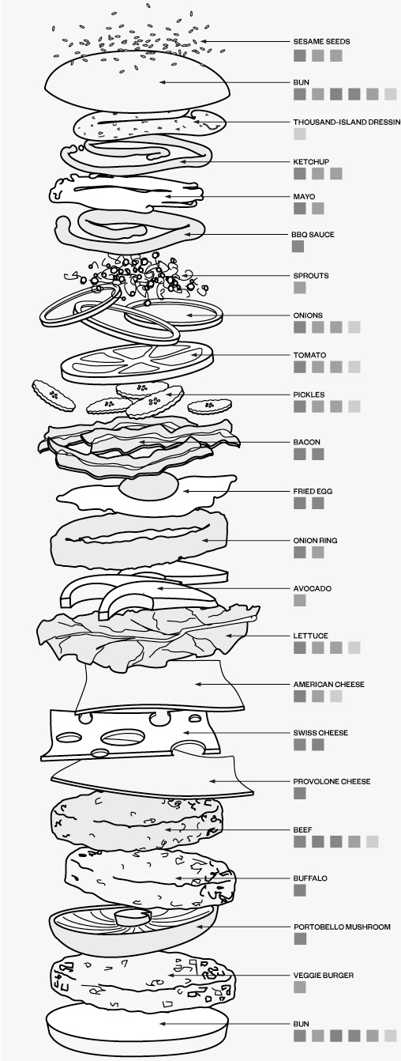
The design environment
Inner environment:
The set of plan alternatives
Outer environment:
Parameters within which alternatives would operate
Finding the alternatives:
Simple list
Assemblies of more basic components
Situation 2 is the most typical

Slide 8

Rational design
Successful design involves relating three sorts of parameters
The means: basic components and their quantities
The laws: unalterable facts about the problem situation
The ends: define what counts as a satisfactory solution, i.e.,
Constraints, e.g., thresholds, tolerances
Utility function, to evaluate alternative designs
Utility function typically amounts to optimality
The best solution to a design problem is the combination of means—the design—that obeys all relevant laws and satisfies all relevant ends in an optimal way.
A best solution is rational because it is optimal
Any rational being would prefer optimal solutions to others

Slide 9
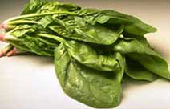
Case study: The diet problem
Means: a list of available foods and quantities
Laws: prices of foods, their nutritional values
Ends:
Nutritional requirements, e.g., < 2000 cal./day, > 10 mg vitamin C, no spinach (!) …
Utility: lowest cost

Slide 10
Summary
Types | Terms | Example: Diet problem
Means | Command variables | List of foods and quantities
Laws | Fixed parameters | Prices of foods Nutritional contents
Ends | Constraints Utility function | Nutritional requirements Cost of diet

Slide 11
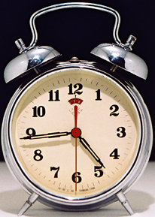
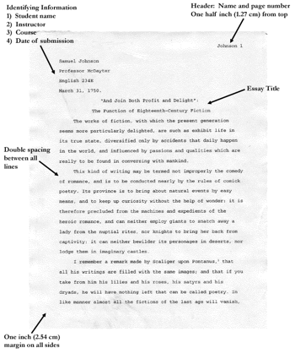
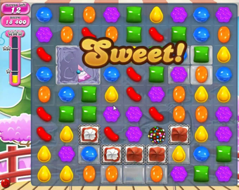
Exercise
Terms | Designs
 | Clock | Essay | Game
Means
Laws
Ends: Constraints Utility function

Slide 12
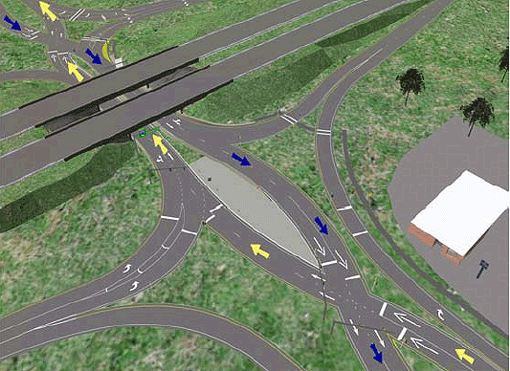
Obstacles to rational design
There are several obstacles to rational design
Our knowledge of inner and outer environments is not perfect, e.g., a highway planning model

Slide 13
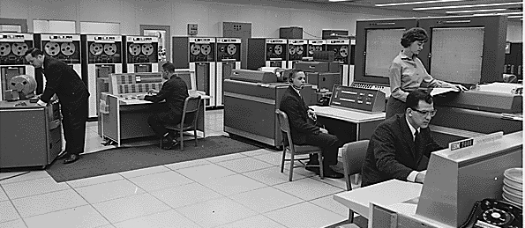
Obstacles: Computing power
We lack the computing capacity to make accurate predictions, even with perfect knowledge, e.g., the travelling salesman problem

Slide 14

Obstacles: Differences
Reasonable people may differ in
Their methods for finding solutions to a problem
Their representations of a problem and its solutions
Arctic sea ice

Slide 15
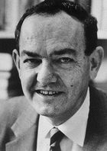
Bounded rationality
We lack the ability to solve non-trivial problems rationally
We can exercise bounded rationality:
Solve problems as well as we know how
Good design applies bounded rationality
No other design is known to be more optimal
All assumptions have worked well before
All assumptions are widely-accepted, e.g., best practices or industry standards
To improve designs, knowledge must increase

Slide 16
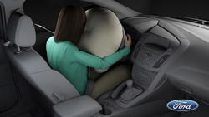
Unintended consequences
In 2013, Toyota recalled cars due to airbag bugs
Spiders built webs in air conditioning condensers, causing water to condense and drip onto air bag controllers
Car designers are not expert in entomology
Can you think of other instances of unintended consequences in design?

